Slide 1

CS 483: Machine Learning
Week 4: Linear and Logistic Regression

Slide 2
Last week
We learned about Bayes’ rule
We learned about Bayesian classifiers
We learned why they are impractical [why?]
We learned about the naïve Bayes classifier,

Slide 3
This week
We will learn about regression
We will learn about a common form of it: linear regression
We will learn how to use linear regression as a classifier: logistic regression
We will start using Scikit-learn

Slide 4
But first, the quiz
Pretend it’s a real test
Suggested to use pencil and paper or type on laptop
No need for calculators

Slide 5
The “quiz”
Suppose the following is a table of counts:
We encounter the instance ( Fluffy = false, Hops = True ). Show your calculations for how you compute the score for IsBunny? using naïve bayes. Don’t use LaPlace smoothing
Fluffy | Hops | IsBunny? (target) | #Instances
True | True | True | 10
False | True | True | 2
True | False | True | 1
True | True | False | 1
False | True | False | 6
True | False | False | 10

Slide 6
Quiz answers
P( IsBunny ) = 13 / 30
P( !Fluffy | IsBunny ) = 2 / 13
P( Hops | IsBunny ) = 12 / 13
nb( IsBunny ) = ( 13 / 30 ) * ( 2 / 13 ) * ( 12 /13 )

Slide 7

Questions?

Slide 8
Regression vs. Classification
We learned about the difference between supervised and un-supervised learning earlier. [what are they?]
We’ve seen classification before. Classification is a supervised ML technique where the model takes a list of features and returns a class.
Regression is when we try to predict a smooth value, instead of a class.
Let’s see some examples.

Slide 9
Regression vs. Classification (examples)
Classification | Regression
Whether or not it will rain | How much it will rain
Whether a tweet is positive, negative, or neutral | How positive or negative a tweet is (maybe a score)
From picture: identify animal or plant species | From picture: estimate age or height of animal/plant
Classify a house as cheap or expensive | Estimate the value of a house
Estimate someone as long-lived | Estimate life span in years
[Your example goes here] | [Your example goes here]

Slide 10
But classifiers can output percentages?
Yes, a classifier can say “I am 60% sure this tweet is positive.”
But a classifier can’t say: “This is a 60% positive tweet.”
See the difference? The training set for a classifier will only have labels { Positive, Neutral, Negative } or something like that.
But the training set for a regression model can have labels like 60%, -50%, 0%, etc. You can explicitly tell it just how negative a tweet is.
So when telling regression from classification, I think it’s better to focus on the training labels than the classifier. If they are categorical or Boolean, it’s classification. If they are numeric, it’s regression.

Slide 11
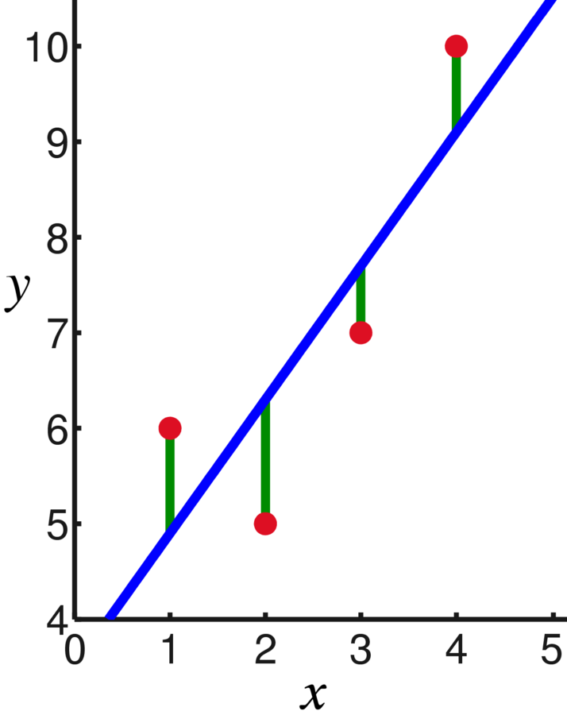
Linear regression
One form of regression is linear regression.
We feed a list of points to the model.
The model is a line that tries to best fit the points.
We use the line to make predictions
Image:, CC0, Oleg Alexandrov, https://en.wikipedia.org/wiki/File:Linear_least_squares_example2.png

Slide 12
How it works
Imagine a dataset of houses.
The non-target features are “square footage”, “number of bedrooms”, and “lot size”.
The target is price in dollars.
So our dataset will look something like this:
Sq. Footage | # Bedrooms | Lot Size (acres) | Sale Price (thou.)
2000 | 5 | 1 | 600
1500 | 3 | 0.2 | 400
1250 | 2 | 0.15 | 350
… | … | … | …

Slide 13
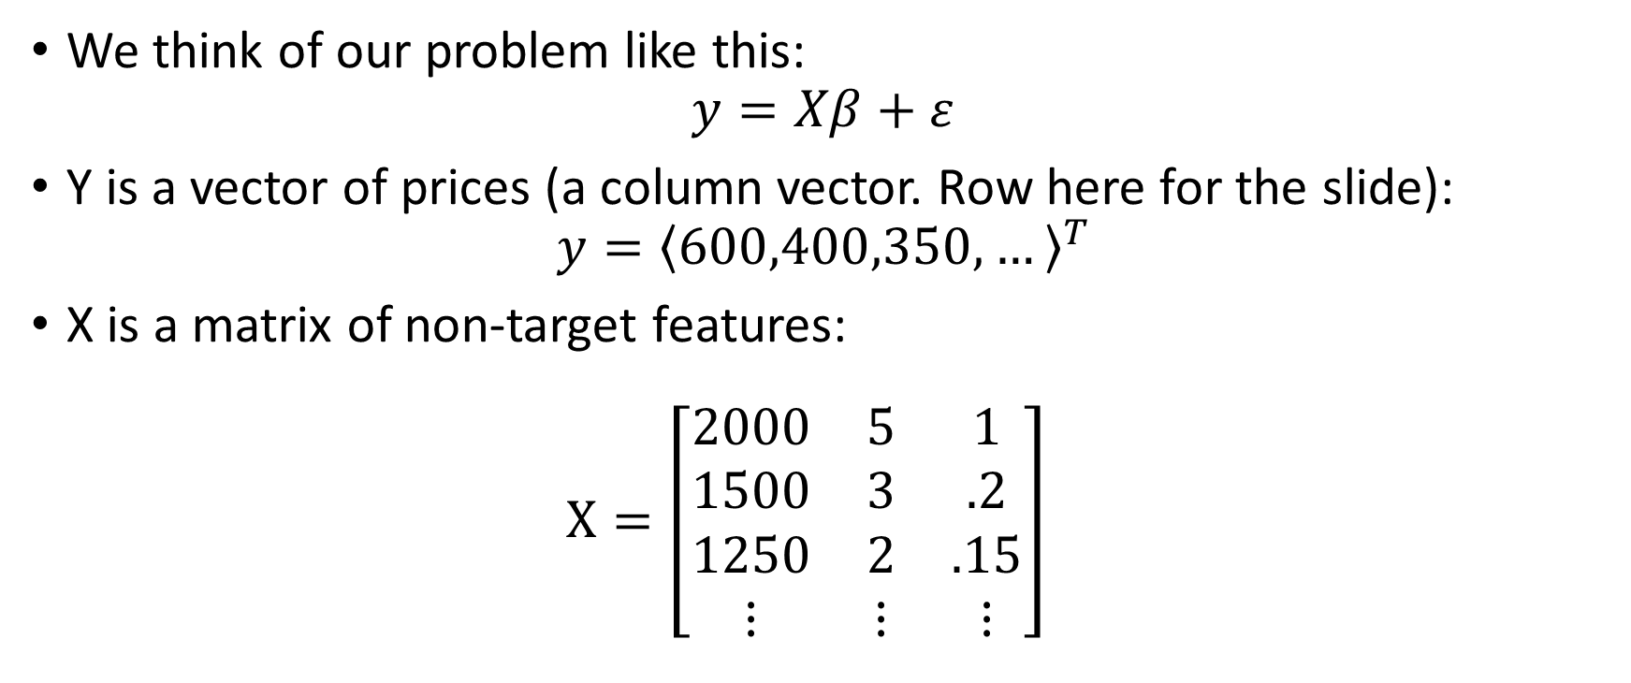
How it works (2)
We think of our problem like this: $y=Xβ+ε$
Y is a vector of prices (a column vector. Row here for the slide): $y={\left\langle 600,400,350,…\right\rangle }^{T}$
X is a matrix of non-target features: $X=\left[\begin{matrix}2000 & 5 & 1 \\ 1500 & 3 & .2 \\ 1250 & 2 & .15 \\ ⋮ & ⋮ & ⋮\end{matrix}\right]$

Slide 14
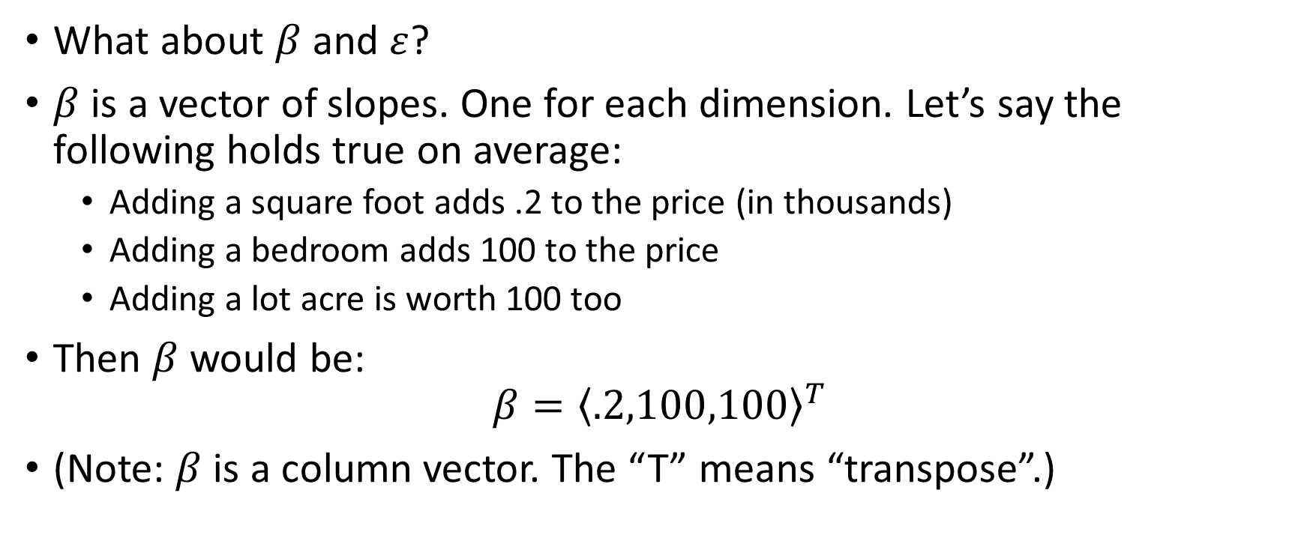
How it works (3)
What about $β$ and $ε$?
$β$ is a vector of slopes. One for each dimension. Let’s say the following holds true on average:
Adding a square foot adds .2 to the price (in thousands)
Adding a bedroom adds 100 to the price
Adding a lot acre is worth 100 too
Then $β$ would be: $β={\left\langle .2,100,100\right\rangle }^{T}$
(Note: $β$ is a column vector. The “T” means “transpose”.)

Slide 15
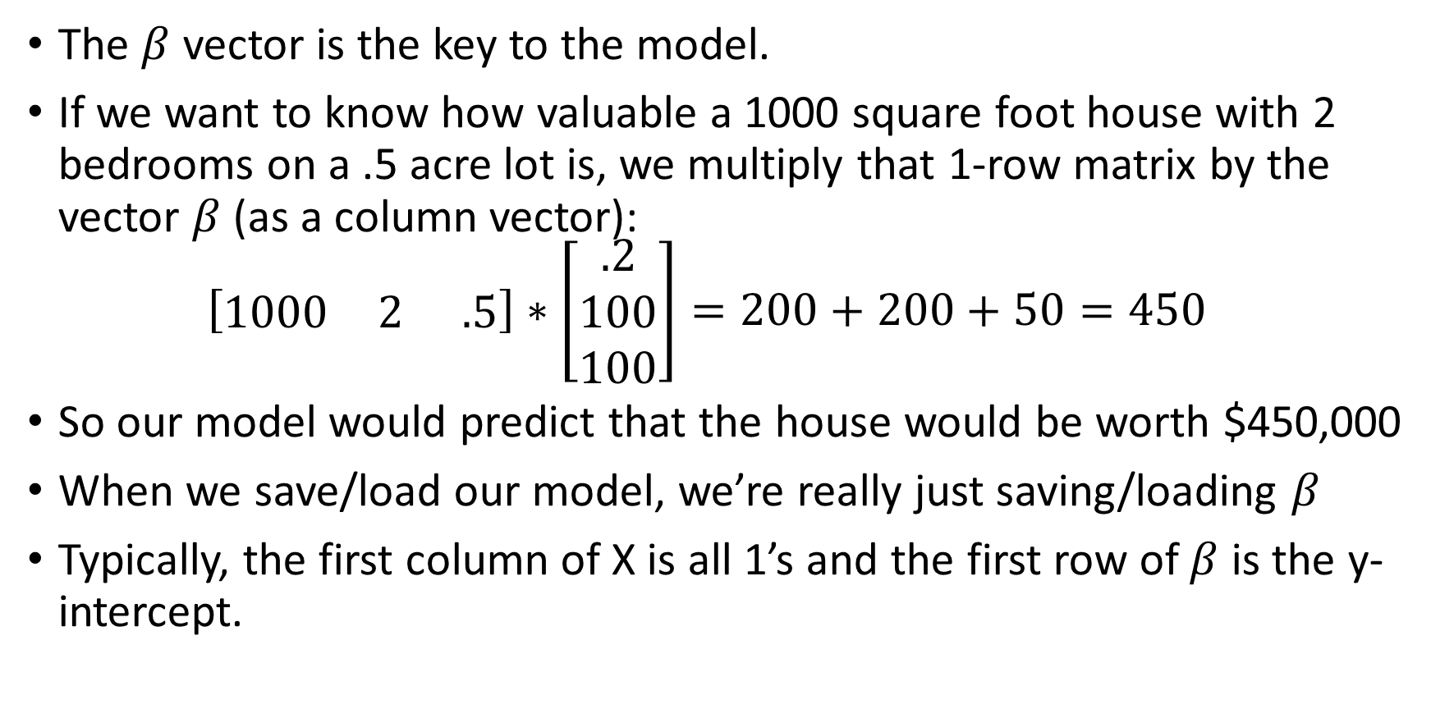
Using this model
The $β$ vector is the key to the model.
If we want to know how valuable a 1000 square foot house with 2 bedrooms on a .5 acre lot is, we multiply that 1-row matrix by the vector $β$ (as a column vector): $\left[\begin{matrix}1000 & 2 & .5\end{matrix}\right]∗\left[\begin{matrix}.2 \\ 100 \\ 100\end{matrix}\right]=200+200+50=450$
So our model would predict that the house would be worth $450,000
When we save/load our model, we’re really just saving/loading $β$
Typically, the first column of X is all 1’s and the first row of $β$ is the y-intercept.

Slide 16
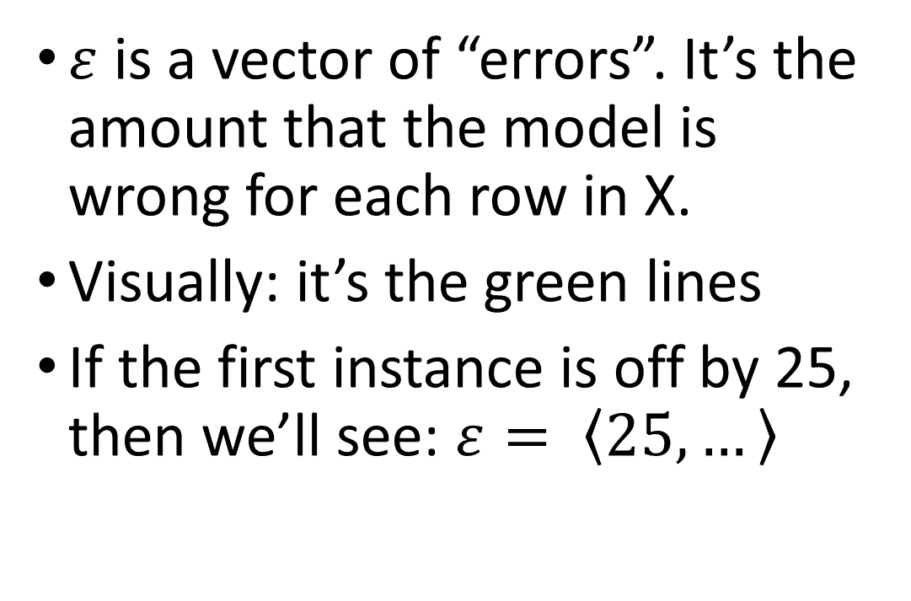
What about e?
$ε$ is a vector of “errors”. It’s the amount that the model is wrong for each row in X.
Visually: it’s the green lines
If the first instance is off by 25, then we’ll see: $ε= \left\langle 25,…\right\rangle$

Slide 17
Questions?

Slide 18
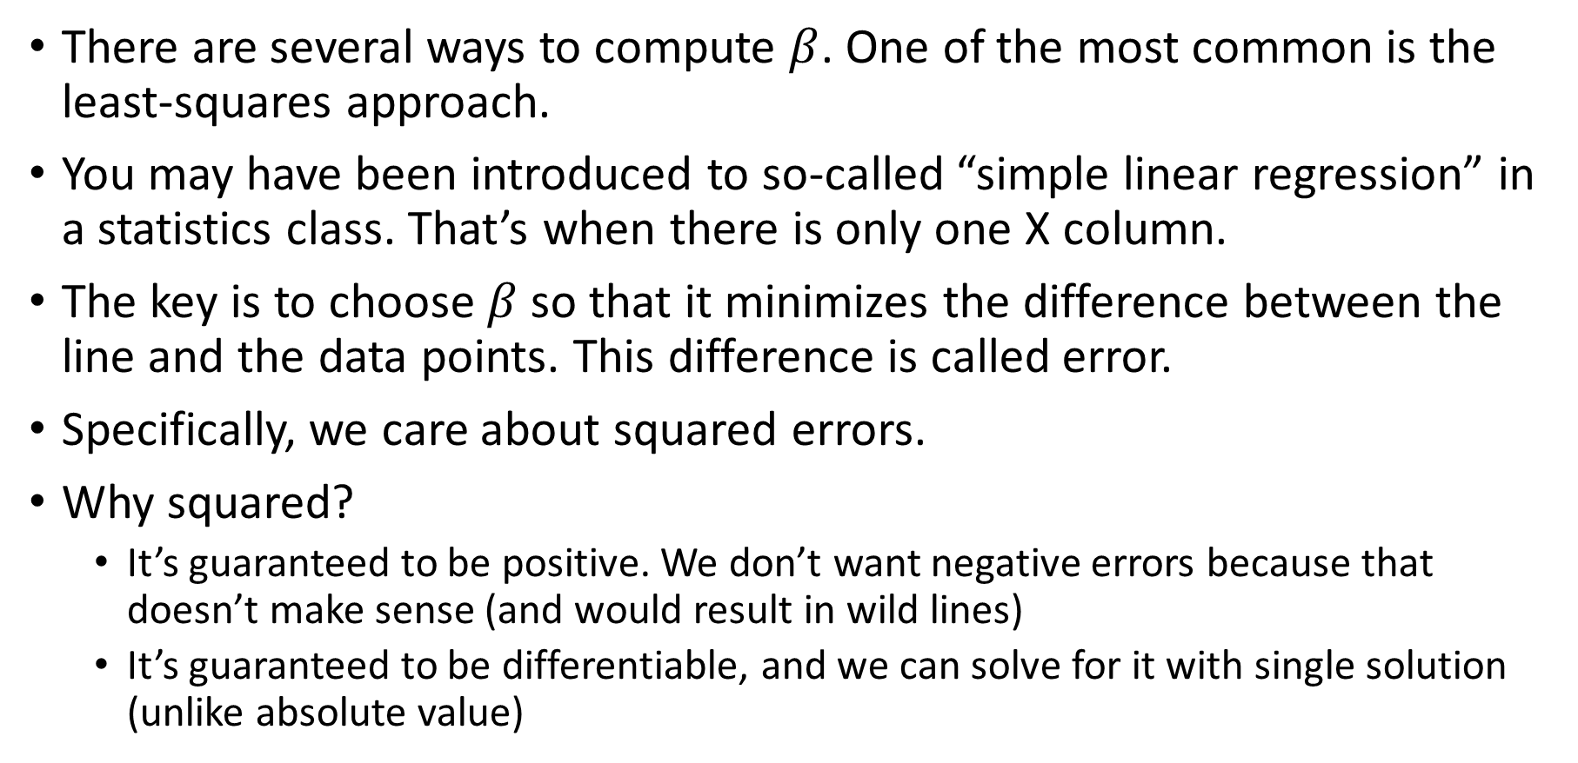
Least-squares
There are several ways to compute $β$. One of the most common is the least-squares approach.
You may have been introduced to so-called “simple linear regression” in a statistics class. That’s when there is only one X column.
The key is to choose $β$ so that it minimizes the difference between the line and the data points. This difference is called error.
Specifically, we care about squared errors.
Why squared?
It’s guaranteed to be positive. We don’t want negative errors because that doesn’t make sense (and would result in wild lines)
It’s guaranteed to be differentiable, and we can solve for it with single solution (unlike absolute value)

Slide 19
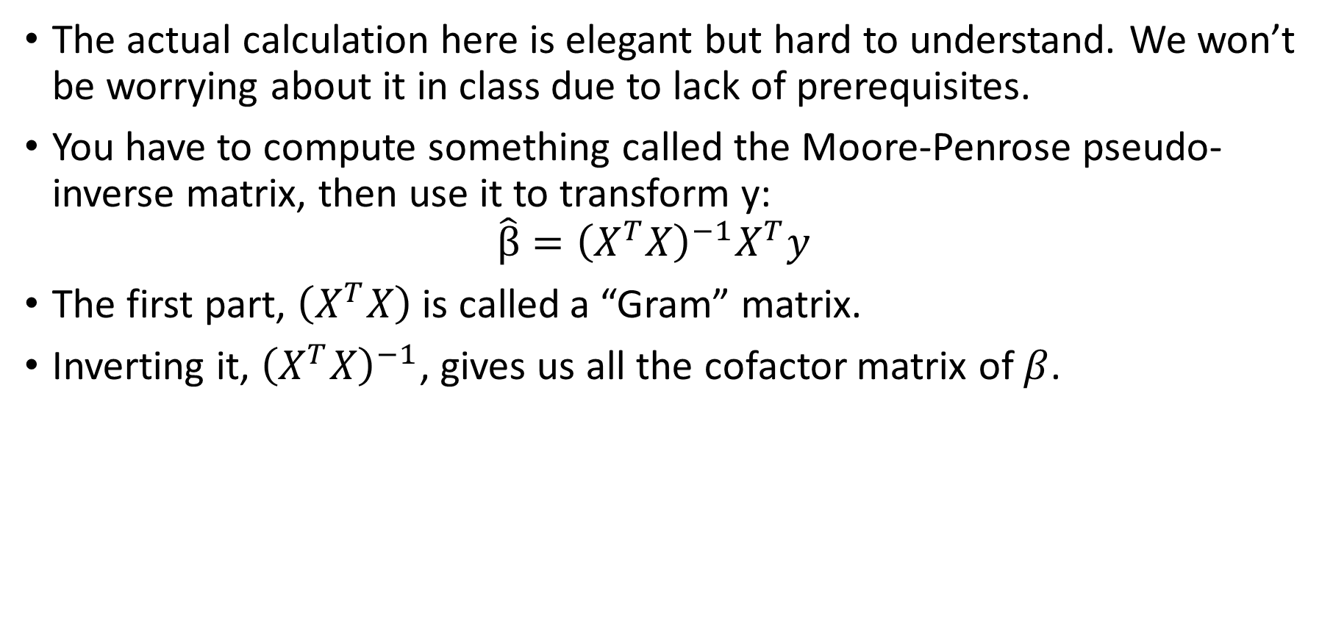
Least-squares (2)
The actual calculation here is elegant but hard to understand. We won’t be worrying about it in class due to lack of prerequisites.
You have to compute something called the Moore-Penrose pseudo-inverse matrix, then use it to transform y: $\hat{β}={\left(X^{T}X\right)}^{−1}X^{T}y$
The first part, $\left(X^{T}X\right)$ is called a “Gram” matrix.
Inverting it, ${\left(X^{T}X\right)}^{−1}$, gives us all the cofactor matrix of $β$.

Slide 20
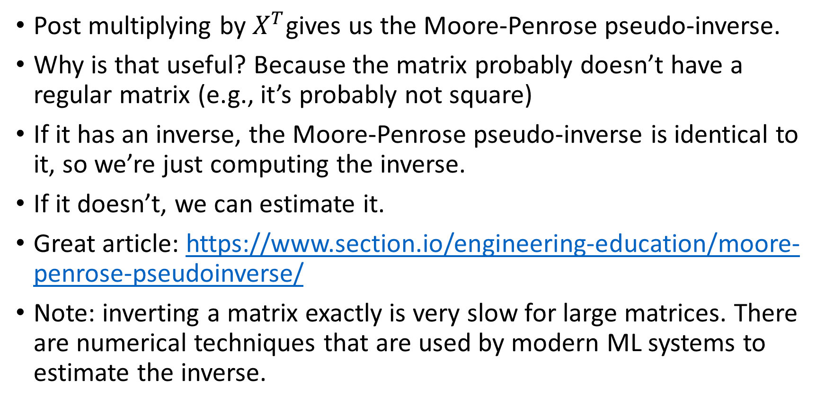
Least-squares (3)
Post multiplying by $X^{T}$gives us the Moore-Penrose pseudo-inverse.
Why is that useful? Because the matrix probably doesn’t have a regular matrix (e.g., it’s probably not square)
If it has an inverse, the Moore-Penrose pseudo-inverse is identical to it, so we’re just computing the inverse.
If it doesn’t, we can estimate it.
Great article: https://www.section.io/engineering-education/moore-penrose-pseudoinverse/
Note: inverting a matrix exactly is very slow for large matrices. There are numerical techniques that are used by modern ML systems to estimate the inverse.

Slide 21
That’s enough math
We’ve seen what’s happening behind the scenes
Let’s learn to use linear regression to solve a real problem
For that, we need a dataset.
Here’s a good one: https://www.kaggle.com/datasets/lespin/house-prices-dataset
It’s a house pricing dataset for Ames, Ohio from quite a while ago. Compiled by Dean De Cock
Problem: there are 81 columns
What do we do?

Slide 22
Let’s see:
I enter this into my notebook (which is on Kaggle. Your file will be different):
data = pd.read_csv( '/kaggle/input/house-prices-advanced-regression-techniques/train.csv’ )
data.columns: Index(['Id', 'MSSubClass', 'MSZoning', 'LotFrontage', 'LotArea', 'Street’, 'Alley', 'LotShape', 'LandContour', 'Utilities', 'LotConfig’, 'LandSlope', 'Neighborhood', 'Condition1', 'Condition2', 'BldgType’, 'HouseStyle', 'OverallQual', 'OverallCond', 'YearBuilt', 'YearRemodAdd’, 'RoofStyle', 'RoofMatl', 'Exterior1st', 'Exterior2nd', 'MasVnrType’, 'MasVnrArea', 'ExterQual', 'ExterCond', 'Foundation', 'BsmtQual’, 'BsmtCond', 'BsmtExposure', 'BsmtFinType1', 'BsmtFinSF1’, 'BsmtFinType2', 'BsmtFinSF2', 'BsmtUnfSF', 'TotalBsmtSF', 'Heating’, 'HeatingQC', 'CentralAir', 'Electrical', '1stFlrSF', '2ndFlrSF’, 'LowQualFinSF', 'GrLivArea', 'BsmtFullBath', 'BsmtHalfBath', 'FullBath’, 'HalfBath', 'BedroomAbvGr', 'KitchenAbvGr', 'KitchenQual’, 'TotRmsAbvGrd', 'Functional', 'Fireplaces', 'FireplaceQu', 'GarageType’, 'GarageYrBlt', 'GarageFinish', 'GarageCars', 'GarageArea', 'GarageQual’, 'GarageCond', 'PavedDrive', 'WoodDeckSF', 'OpenPorchSF’, 'EnclosedPorch', '3SsnPorch', 'ScreenPorch', 'PoolArea', 'PoolQC’, 'Fence', 'MiscFeature', 'MiscVal', 'MoSold', 'YrSold', 'SaleType’, 'SaleCondition', 'SalePrice'],dtype='object')

Slide 23
Okay, let’s take a subset
What features are important?
Square footage seems like a good one. It’s broken down by floor (1stFlrSF, 2ndFlrSF), however, there is a GrLivArea which stands for “(above) ground living area”, which is probably what we want.
It still doesn’t include Basements.
Notice how it’s kind of hard to even figure out what stuff is. It’s very important to read the description here: https://www.kaggle.com/competitions/house-prices-advanced-regression-techniques/data
Some of the descriptors might require you to be familiar with local county/township zoning and lot-size requirements. What does “slightly irregular” lot shape represent (as opposed to “moderately irregular”)

Slide 24
Selecting important columns
data[['GrLivArea','OverallQual', 'OverallCond', 'BedroomAbvGr', 'SalePrice']].head()
SalePrice is the target. [What kind of relationship do you expect each of these columns to have with the SalePrice]?
 | GrLivArea | OverallQual | OverallCond | BedroomAbvGr | SalePrice
0 | 1710 | 7 | 5 | 3 | 208500
1 | 1262 | 6 | 8 | 3 | 181500
2 | 1786 | 7 | 5 | 3 | 223500
3 | 1717 | 7 | 5 | 3 | 140000
4 | 2198 | 8 | 5 | 4 | 250000

Slide 25
Weird pandas syntax
You may have noticed that sometimes we use dataframes like this: data[ ‘Column’ ]
This gives us the column data as a sequence.
However, sometimes you see this: data[ [ ‘Column1’, ‘Column2’ ] ]
The extra pair of brackets is because we are using a list (an array) to index the dataframe.

Slide 26
Let’s plot correlations
In order to pick a good set of features, one of the first things we want to do is determine their relationship to each other.
Important relationship: correlations. We want a good selection of features that are as independent as possible. If two features are correlated, the model will tend to learn lower importance of each individual feature.
First: let’s install matplotlib, a library for drawing graphs (plots): conda activate machine_learning conda install matplotlib

Slide 27
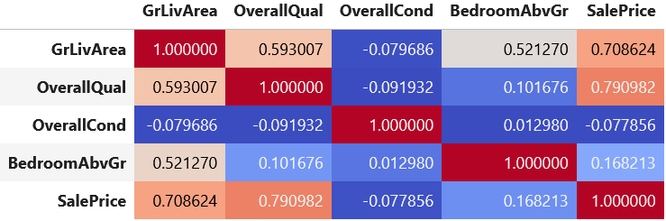
Viewing the correlations
corr = data.corr()
corr.style.background_gradient( cmap = 'coolwarm’ ) (note: pandas dataframes can have style information. Here, we’re choosing a background gradient)
[What does this tell us?]

Slide 28
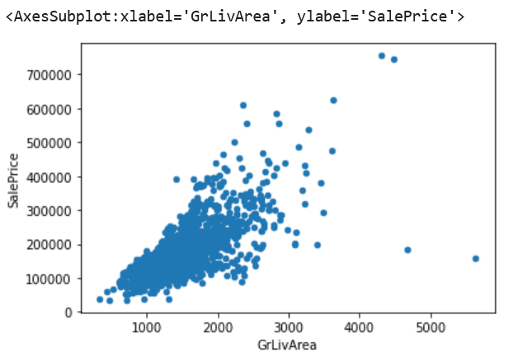
What it tells us
Square footage is closely correlated with price, which is expected.
It also appears to be a linear correlation
Is it really? Let’s see: data.plot.scatter( 'GrLivArea', 'SalePrice’ )
[What do we think?]

Slide 29
My thoughts
It looks pretty linear, but it has spread
That spread is the error. It’s the deviation between the line (which we haven’t found yet) and the observation (the instance)
Clearly we need more than just square footage for an accurate model. We want to explain that variance by adding more information.
For example, we could learn that part of what explains the spread is differences in quality.
What does that chart look like?

Slide 30
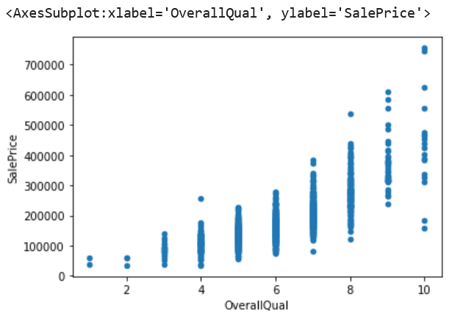
Overall quality
Here we see a discrete feature
There are gaps between lines, but we can see that, overall, more quality means more money.
There is lots of variance here, though.

Slide 31
Plotting both (brace yourself)
import plotly.express as py
fig = py.scatter_3d( data, 'GrLivArea’, 'OverallQual’, 'SalePrice’, color = 'SalePrice’, size_max = 15, size = 'SalePrice’ # this is a hack [I’ll explain] )
fig.show()

Slide 32
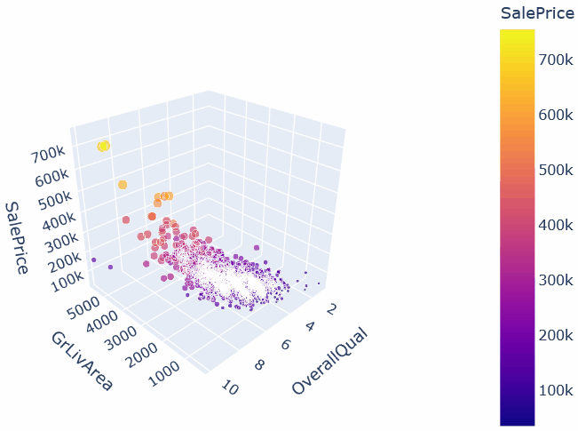
3D scatter plot
If you want to do this: conda install plotly

Slide 33
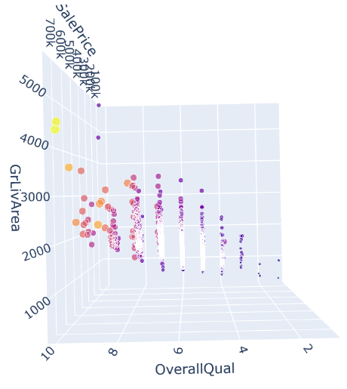
Last plot
Why do extra dimensions help?
Notice: square footage helps explain the variance in quality.
Why should two quality 5 houses sell for such different amounts? Because one is bigger. (look at color)

Slide 34
Verdict
These observations give us more confidence that our model really does have linear behavior.
If we saw weird curves, clusters, or circles in our data, we’d want to look for a different kind of model (a curve is not in the hypothesis space of a linear model)
Actually, there is kind of a little bit of a curve in this data. Price seems to skew up a little bit.
We will adjust for that skew next class by doing a transformation. If you’re curious, look at YearBuilt vs. SalePrice to see it very strikingly.

Slide 35
Questions?

Slide 36
Finally using Sci-kit learn
Okay, let’s learn to use sci-kit learn
First, sci-kit learn has a complicated package structure, but it’s well-named.
All of the linear regressors and classifiers, including linear regression, are in sklearn.linear_model
So, let’s import the linear regression regressor: from sklearn.linear_model import LinearRegression

Slide 37
Constructing the model
To create a model, first we create it like this: model = LinearRegression( n_jobs = -1 )
n_jobs is the number of threads we want SK-Learn to use to train the model. The more we use, the faster it trains. -1 means “as many as you can”.
Once the model is constructed, it’s still not ready to use. We need to to train the model.
Training in SK-Learn is done with the method “fit”. This is a term from statistics, applied to machine learning so that we can use the same method to fit statistical estimators as machine learning models.

Slide 38
Preparing the dataset
Let’s select the columns we looked at: data2 = data[ [ 'GrLivArea', 'OverallQual', 'SalePrice' ] ]
Remember, we don’t test the model with the same data we trained it on.
We need to first split between train and test: train = data2.sample( frac = 0.7 ) test = data2.drop( train.index )
But this isn’t enough. The training data contains the target! The model would learn that the most important feature for predicting ‘SalePrice’ is ‘SalePrice’
We have to split our training data into X and y. X contains the non-target feature, and y is only the target feature: train_x = train.drop( columns = [ 'SalePrice' ] ) train_y = train[ 'SalePrice' ]

Slide 39
Fitting the model
This part is easy: model.fit( train_x, train_y )
That’s it. The model is now trained.
Linear regression is very fast, it will likely fit in less than a second.
So now we have a model. What now?

Slide 40
Predicting with the model
The way you “use” a model is with the method “predict”
test_x = test.drop( columns = [ 'SalePrice' ] ) model.predict(test_x[0 : 3] )
result: array([164307.09997513, 220950.11052843, 278913.32156594])
What house instances do these correspond to? test[0:3] =
GrLivArea | OverallQual | SalePrice
1262 | 6 | 181500
1717 | 7 | 140000
2198 | 8 | 250000

Slide 41
How is it?
Not terrible.
The middle house prediction was pretty far off, but based on these two features, it seems to be underpriced. (there might be another feature that says “totally taken over by mold” which explains the price)
But how do we measure error more rigorously?
test_y = test[ [‘SalePrice’] ] model.score( test_x, test_y )
Result: 0.7210512328605168
Okay…what does that mean?

Slide 42
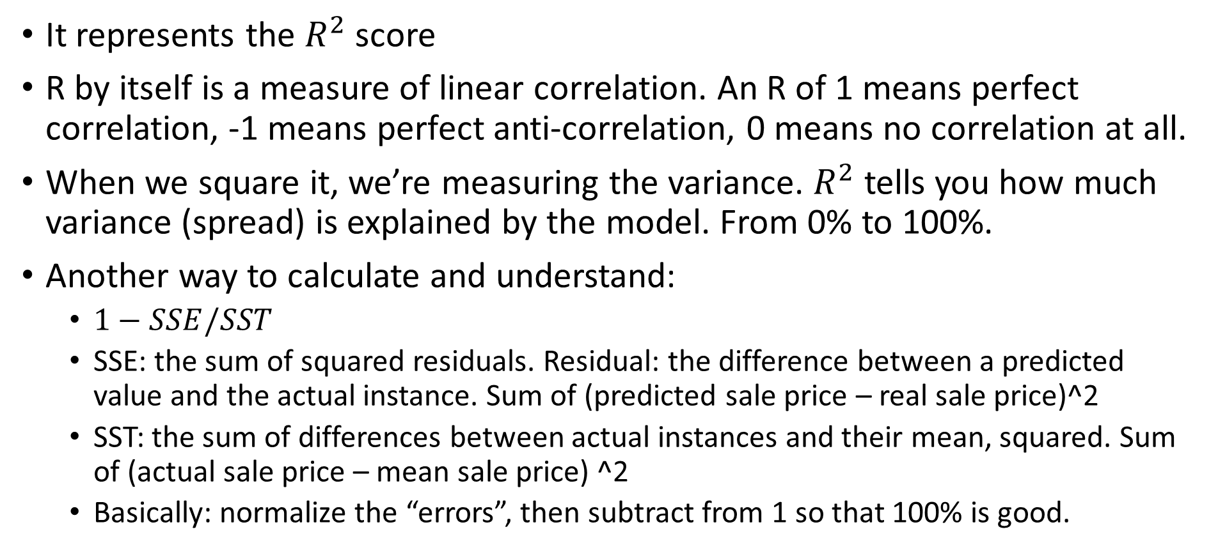
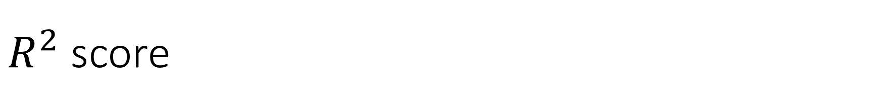
$R^{2}$ score
It represents the $R^{2}$ score
R by itself is a measure of linear correlation. An R of 1 means perfect correlation, -1 means perfect anti-correlation, 0 means no correlation at all.
When we square it, we’re measuring the variance. $R^{2}$ tells you how much variance (spread) is explained by the model. From 0% to 100%.
Another way to calculate and understand:
$1−SSE/SST$
SSE: the sum of squared residuals. Residual: the difference between a predicted value and the actual instance. Sum of (predicted sale price – real sale price)^2
SST: the sum of differences between actual instances and their mean, squared. Sum of (actual sale price – mean sale price) ^2
Basically: normalize the “errors”, then subtract from 1 so that 100% is good.

Slide 43
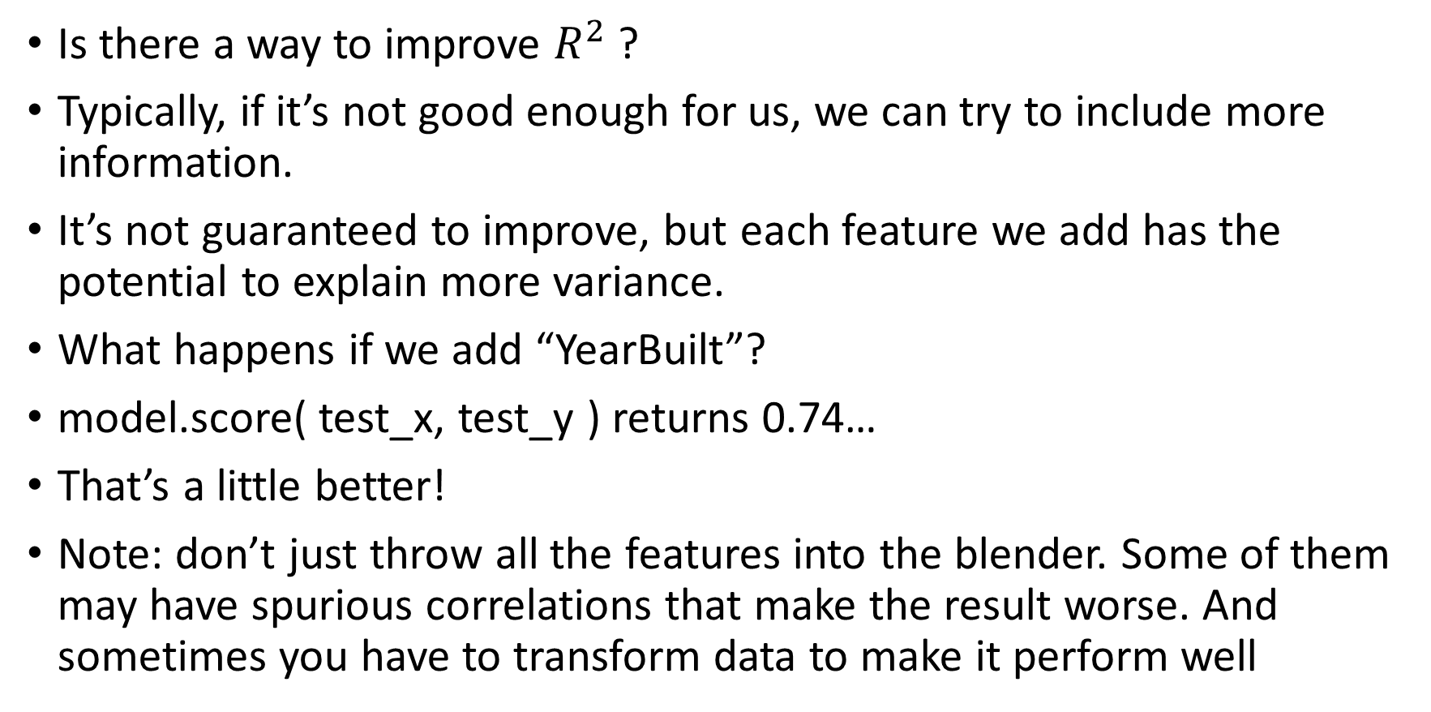

Improving $R^{2}$
Is there a way to improve $R^{2}$ ?
Typically, if it’s not good enough for us, we can try to include more information.
It’s not guaranteed to improve, but each feature we add has the potential to explain more variance.
What happens if we add “YearBuilt”?
model.score( test_x, test_y ) returns 0.74…
That’s a little better!
Note: don’t just throw all the features into the blender. Some of them may have spurious correlations that make the result worse. And sometimes you have to transform data to make it perform well

Slide 44
Remember:
You want features that are correlated or anti-correlated with the target.
If you have a feature that is perfectly correlated or anti-correlated, you solved the problem already (just use that feature)
On the other hand, you do not want features that are too correlated with each other.
So, look at your table of correlations. Find features that are correlated to the target and not correlated with each other. This will help you choose the best features.

Slide 45
What about more concrete error?
An easy to understand error for humans is “mean absolute error”
It’s like squared error, but we just take the absolute value between the difference between estimated sale price and actual sale price.
We have to be careful using it, because it doesn’t give us a relative number. It’s a big deal to be off by $5,000 for a tiny-home worth $35,000, but not a big deal if the home is worth a million.
However, it might be interesting. How do we get it?

Slide 46
Computing an error metric
Metrics are functions that take two arguments. One for predicted target values (predicted prices), one for actual target values (actual prices):
from sklearn.metrics import mean_absolute_error pred_y = model.predict( test_x ) mae = mean_absolute_error( test_y, pred_y )
mae = 27874. …
So, on average, off by about 27 thousand dollars.

Slide 47
Percentage error
To correct for that effect we mentioned, where we treat being off by some amount the same, regardless of if it’s on a small house or a big one, we can use mean absolute percentage error (MAPE)
How to understand this: if our MAPE score is 20%, then on average our predicted values are 20% off.
What is the MAPE for our estimator? About 15%. Not terrible.
Kind of amazing if you think about it. We can, just knowing the acreage, square footage, and home inspector evaluation, predict the market value of the home within 15% on average.

Slide 48
Questions?

Slide 49
What about classification
Let’s turn this into a classification problem
Instead of predicting the value of a house, let’s predict whether it’s cheap or expensive.
Is it possible to use linear regression as a classifier?
At first glance, it doesn’t seem possible, but it is with some creativity.
[How would you do it?]

Slide 50
How would linear regression classify?
The output of a classifier is either a label or a probability.
Can we predict probability with the regressor?
For example, instead of asking it to predict a price, like $200,000, what if we asked it to predict a probability?
The dataset would say 100% for the expensive houses and 0% for the cheap ones (because this is a classification problem, we don’t allow in-between)
We could totally build this classifier, but it would have problems.

Slide 51
Problem 1: no upper bound
First problem: linear regression supports infinite y-values
We want to limit our prediction to between 0% and 100%.
But there’s no obvious way to limit linear regression like this. Lines go on forever, so no matter what slope we use (except 0), if our house is valuable enough, we will end up going above 100%
What does a 110% probability mean? Super true?
This probably would work okay for house prices, we could just take >50% as true. But it means we can’t use probabilistic reasoning (If the house is 110% expensive, what percent is it cheap? -10%?)

Slide 52
Problem 2: No lower bound
We want the lowest possible probability to be zero.
The problem: it’s actually possible for a house to be worth negative dollars.
Nothing stops linear regression from giving negative probabilities.
We end up with the same problem in reverse. What is a probability of -10%?

Slide 53
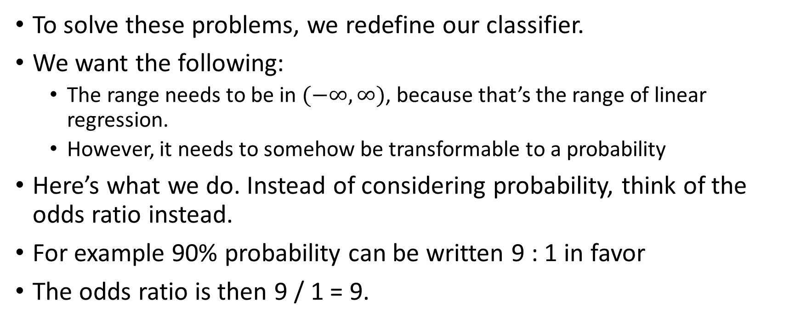
Solving these problems
To solve these problems, we redefine our classifier.
We want the following:
The range needs to be in $(−∞,∞)$, because that’s the range of linear regression.
However, it needs to somehow be transformable to a probability
Here’s what we do. Instead of considering probability, think of the odds ratio instead.
For example 90% probability can be written 9 : 1 in favor
The odds ratio is then 9 / 1 = 9.

Slide 54
Solving these problems (2)
This isn’t enough, because it’s not linear
As the denominator gets smaller, the ratio grows exponentially.
9 : 1 odds is 9, but 9 : 0.5 odds is 18. And 9 : 0 odds is infinity. The odds ratio is challenging to predict, because it has non-linear behavior.
Linearizing it is easy however: just take the logarithm. That turns it from an exponential into a linear function.
The unit of measurement for log odds is called “logit” (logistic unit). So this is sometimes called logit regression.
https://en.wikipedia.org/wiki/Logistic_regression

Slide 55
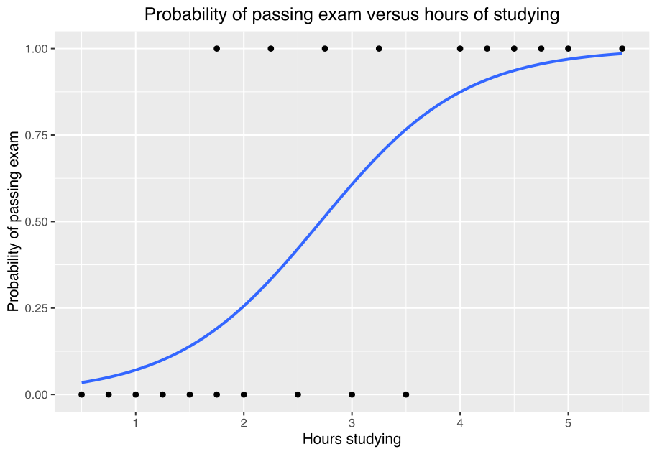
Intuition behind logistic regression
One way of thinking about logistic regression is that it’s linear regression but we “bend” the end points so that they can’t be larger than 1 or smaller than 0.
This is called a logistic curve.
In fact, the logistic curve (or S-shaped curve) will never reach 1 or 0, it just gets infinitely close
The logistic curve shows up everywhere in nature [examples]
Image: Canley, CC-BY-SA 4.0, https://en.wikipedia.org/wiki/File:Exam_pass_logistic_curve.svg

Slide 56
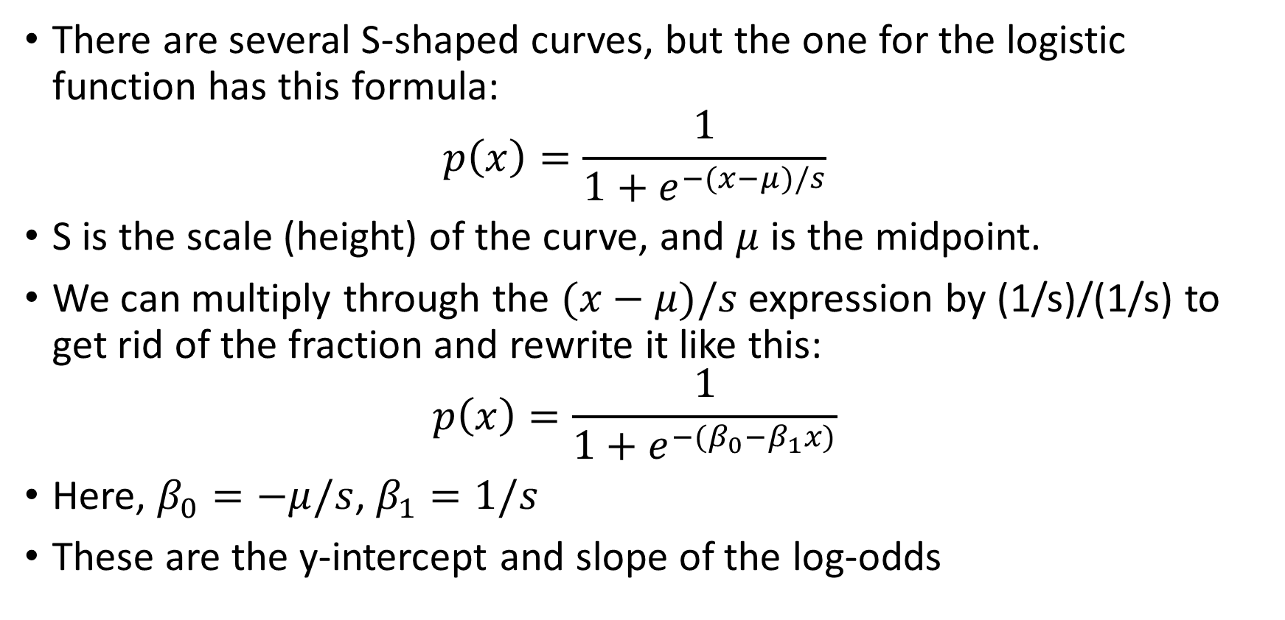
The curve
There are several S-shaped curves, but the one for the logistic function has this formula: $p\left(x\right)=\frac{1}{1+e^{−(x−μ)/s}}$
S is the scale (height) of the curve, and $μ$ is the midpoint.
We can multiply through the $(x−μ)/s$ expression by (1/s)/(1/s) to get rid of the fraction and rewrite it like this: $p\left(x\right)=\frac{1}{1+e^{−(β_{0}−β_{1}x)}}$
Here, $β_{0}=−μ/s$, $β_{1}=1/s$
These are the y-intercept and slope of the log-odds

Slide 57
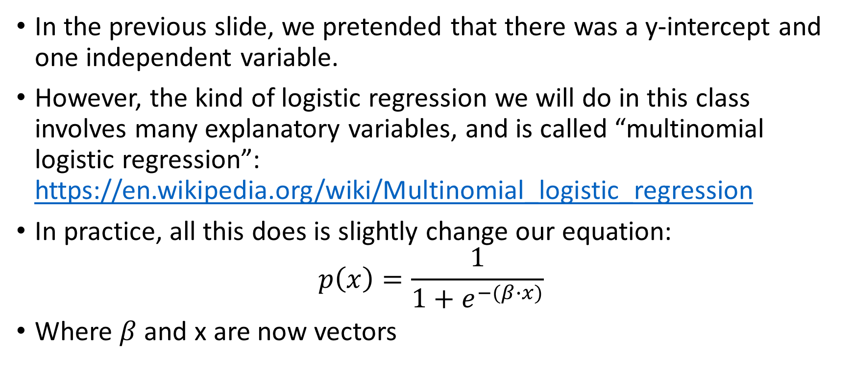
More variables
In the previous slide, we pretended that there was a y-intercept and one independent variable.
However, the kind of logistic regression we will do in this class involves many explanatory variables, and is called “multinomial logistic regression”: https://en.wikipedia.org/wiki/Multinomial_logistic_regression
In practice, all this does is slightly change our equation: $p\left(x\right)=\frac{1}{1+e^{−(β∙x)}}$
Where $β$ and x are now vectors

Slide 58
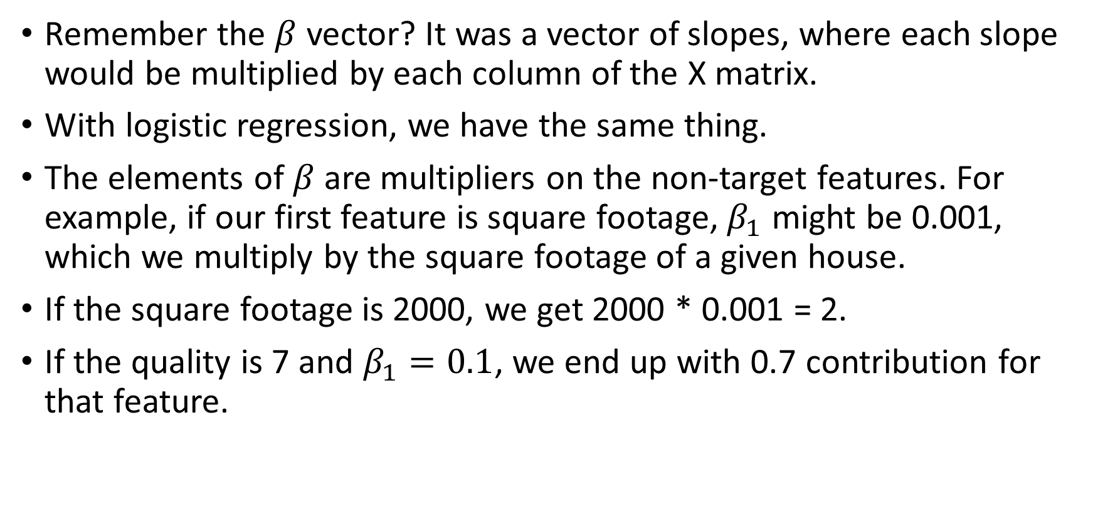
How do we predict with it?
Remember the $β$ vector? It was a vector of slopes, where each slope would be multiplied by each column of the X matrix.
With logistic regression, we have the same thing.
The elements of$β$ are multipliers on the non-target features. For example, if our first feature is square footage, $β_{1}$ might be 0.001, which we multiply by the square footage of a given house.
If the square footage is 2000, we get 2000 * 0.001 = 2.
If the quality is 7 and $β_{1}=0.1$, we end up with 0.7 contribution for that feature.

Slide 59
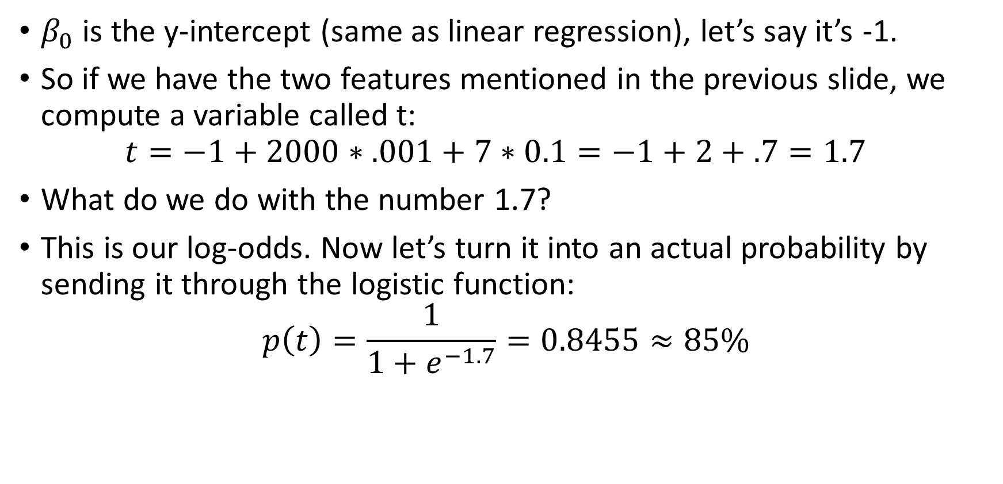
How do we predict with it? (2)
$β_{0}$ is the y-intercept (same as linear regression), let’s say it’s -1.
So if we have the two features mentioned in the previous slide, we compute a variable called t: $t=−1+2000∗.001+7∗0.1=−1+2+.7=1.7$
What do we do with the number 1.7?
This is our log-odds. Now let’s turn it into an actual probability by sending it through the logistic function:
$$p\left(t\right)=\frac{1}{1+e^{−1.7}}=0.8455≈85\%$$

Slide 60
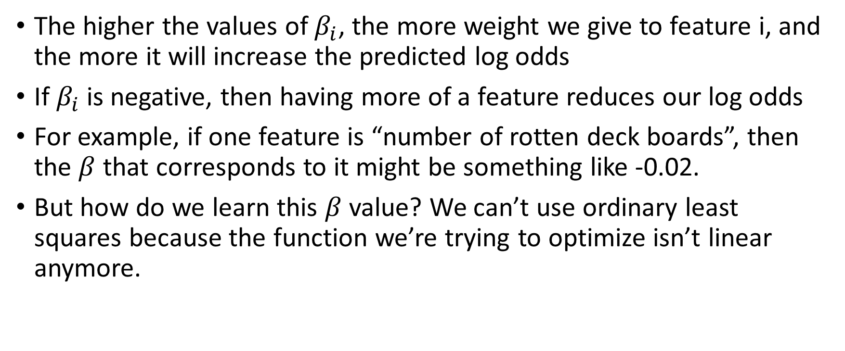
The intuition
The higher the values of $β_{i}$, the more weight we give to feature i, and the more it will increase the predicted log odds
If $β_{i}$ is negative, then having more of a feature reduces our log odds
For example, if one feature is “number of rotten deck boards”, then the $β$ that corresponds to it might be something like -0.02.
But how do we learn this $β$ value? We can’t use ordinary least squares because the function we’re trying to optimize isn’t linear anymore.

Slide 61
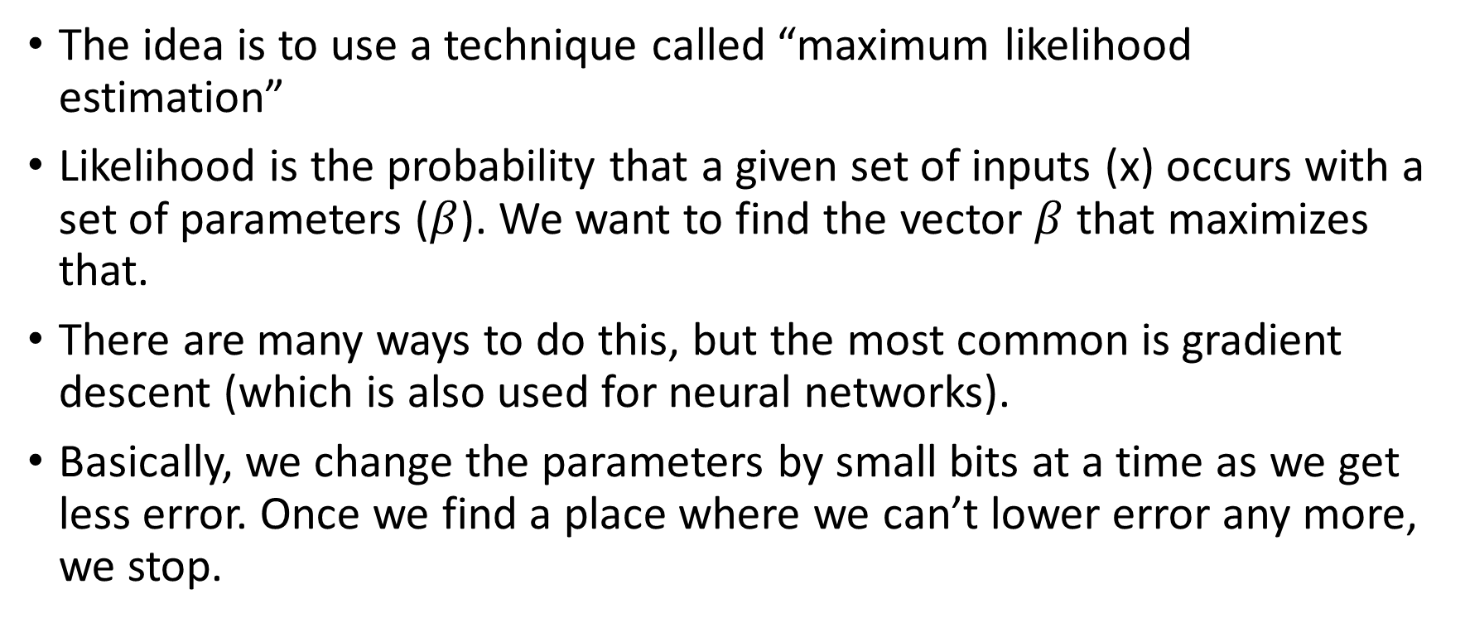
Maximum likelihood
The idea is to use a technique called “maximum likelihood estimation”
Likelihood is the probability that a given set of inputs (x) occurs with a set of parameters ($β$). We want to find the vector $β$ that maximizes that.
There are many ways to do this, but the most common is gradient descent (which is also used for neural networks).
Basically, we change the parameters by small bits at a time as we get less error. Once we find a place where we can’t lower error any more, we stop.

Slide 62
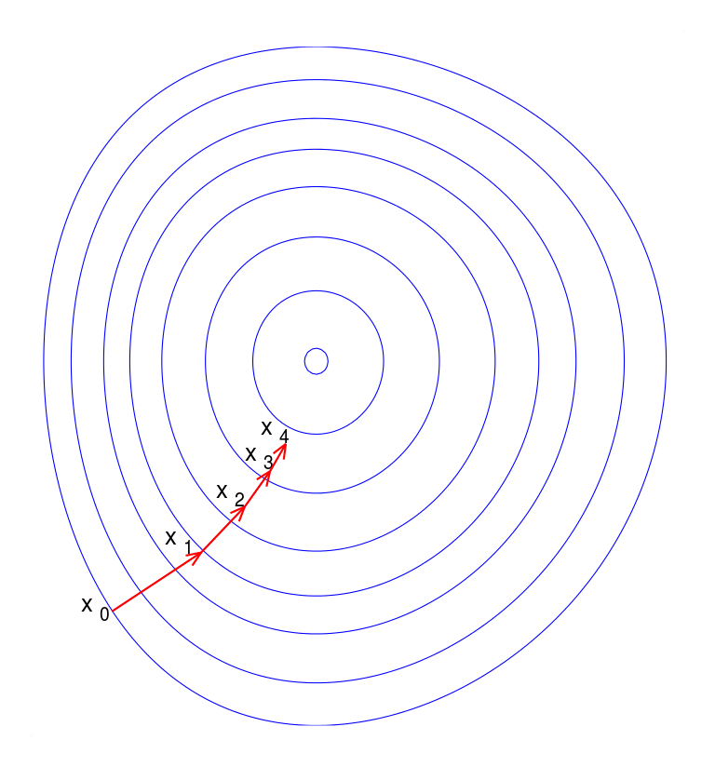
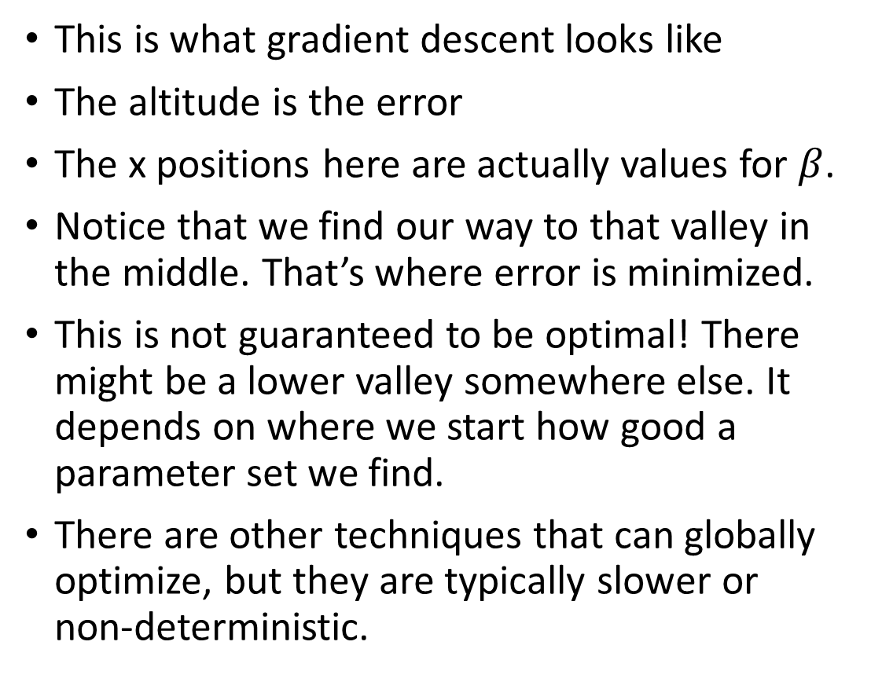
Gradient descent
This is what gradient descent looks like
The altitude is the error
The x positions here are actually values for $β$.
Notice that we find our way to that valley in the middle. That’s where error is minimized.
This is not guaranteed to be optimal! There might be a lower valley somewhere else. It depends on where we start how good a parameter set we find.
There are other techniques that can globally optimize, but they are typically slower or non-deterministic.

Slide 63
Questions?

Slide 64
Making classes
Okay, that’s how logistic regression works. Now let’s use it to classify houses between cheap and expensive.
What is cheap? Let’s use the median to decide: data['SalePrice'].median() => 163000.0
That’s our midpoint. How do we create a new dataset for classification?
Pandas makes it easy to make new columns. We can make a new “IsExpensive” column, and then drop the old “SalePrice” column.
Is there a fast way to do this?

Slide 65
Creating a column
First, let’s make a copy of our original data frame: data3 = data2[:]
We need to define a function that will tell us if an instance is expensive or not. We will run this on every instance: def is_expensive( row ): return int( row[ 'SalePrice' ] > 163000 )
Now, let’s apply this function to our dataframe to create a new list of 1’s and 0’s. It will be the data we use to create a new column: new_column = data3.apply( is_expensive, axis = 1 )
Apply takes a function (can be a lambda) and calls it on every row. The return values are the values of a new series.
This is similar to “map”, (the functional programming operator)

Slide 66
Adding the column to the frame
We use the “insert” method to add a column: data3.insert( len(data3.columns), 'IsExpensive', new_column )
The first argument is what order the column should be. I like targets to be last in the list of columns, so I use len(data3.columns) to ensure this happens.
The second argument is the name of the new column. The last argument is the series that will contain the values.
All we have to do is drop the old “SalePrice” argument (don’t want the classifier to see that, otherwise it would use it to make predictions): data3 = data3.drop( columns = ['SalePrice'] )

Slide 67
What do we get?
data3.head()
Looks good. Let’s use it with logistic regression.
 | GrLivArea | OverallQual | OverallCond | BedroomAbvGr | YearBuilt | IsExpensive
0 | 1710 | 7 | 5 | 3 | 2003 | 1
1 | 1262 | 6 | 8 | 3 | 1976 | 1
2 | 1786 | 7 | 5 | 3 | 2001 | 1
3 | 1717 | 7 | 5 | 3 | 1915 | 0
4 | 2198 | 8 | 5 | 4 | 2000 | 1

Slide 68
Preparing data to train and test
We have a similar set of steps to go through, except our target column has a different name: train = data3.sample( frac = 0.7 ) train_x = train.drop( columns = [ 'IsExpensive' ] ) train_y = train[ 'IsExpensive’ ] test = data3.drop( train.index ) test_x = test.drop( columns = [ 'IsExpensive' ] ) test_y = test[ 'IsExpensive' ]

Slide 69
Initializing and fitting the model
It’s very similar to linear regression. We basically just replace “linear” with “logistic” and everything works: from sklearn.linear_model import LogisticRegression model2 = LogisticRegression( n_jobs = -1 )
Now fit the new model: model2.fit( train_x, train_y )

Slide 70
Using the model
We can use predict like we did before: model2.predict( test_x )
This will give us a list of 1s and 0s.
However, if we want probabilities, we can use the additional function, predict_proba: model2.predict_proba( test_x ) => array([[6.07997017e-03, 9.93920030e-01], [6.16321333e-02, 9.38367867e-01], [9.32074983e-01, 6.79250171e-02], ... )

Slide 71
Interpreting the results
The output of predict_proba is an array of arrays.
Each row is an array of two values.
The first value of the row array is the probability that the label is 0, the second is the probability that the label is 1.
If we were predicting a categorical target with 3 values (low_price, medium_price, high_price), the array would have 3 values instead of 2.
The values sum to 1. We’re interested in the second value: the probability that the house is expensive.

Slide 72
Sample predition
Consider these test values:
The model predicts: array([[0.00607997, 0.99392003], [0.06163213, 0.93836787],[0.93207498, 0.06792502]])
This means 99%, 94%, 7%. Unfortunately it misses the middle value, but gets the other two right.
GrLivArea | OverallQual | YearBuilt | IsExpensive
2198 | 8 | 2000 | 1
1774 | 7 | 1931 | 0
1077 | 5 | 1939 | 0

Slide 73
Estimating accuracy
We’ll talk about how to evaluate classifiers later in the semester.
For now, let’s keep things simple: accuracy.
We know our dataset is balanced because we took the median to determine whether the property was cheap or expensive, so accuracy is actually a useful metric.
How do we compute it?
First, let’s get the list of predictions: predictions = model2.predict( test_x )

Slide 74
Using metrics
Just like we did with MAPE et. al., we can use a metric function
This time, we use “accuracy_score”: from sklearn.metrics import accuracy_score accuracy_score( test_y, predictions )
Result: 86.5%
Not bad.

Slide 75
Questions?

Slide 76
Quiz next class
Make sure you understand how to use the features of pandas we saw here.
Specifically:
Sampling
Dropping columns
Inserting columns
Apply
Selecting multiple columns
You might be asked to prepare data by splitting it into train, test dataframes like we did here.

Slide 77
Quiz next class
Make sure you understand how to use models in sk-learn
First, we construct them: model = SomeModel( … )
Then, we fit them on the data we prepared: model.fit( train_x, train_y, … )
We can use the model to make predictions: pred_y = model.predict( test_x )
And we can compare our predictions to the real y values: acc = accuracy_score( test_y, pred_y )

Slide 78
Questions?

